Slide 1
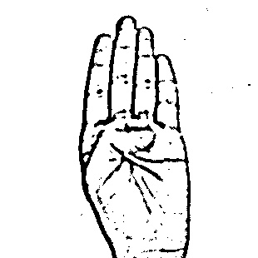
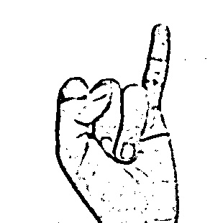
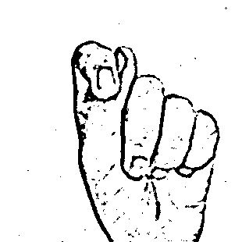
Conversion of
Sign Language (ASL) to Text
B I T
Mentor : Mr. Sachin Kumar Agrawal,
Assistant Professor, Dept of IT, BIT SINDRI
Abhay Kumar | Adarsh Kumar | Amit Oraon | Anibrato Adhikari | Ranjan Kr. Choubey | Tanveer Azam Ansari

Slide 2
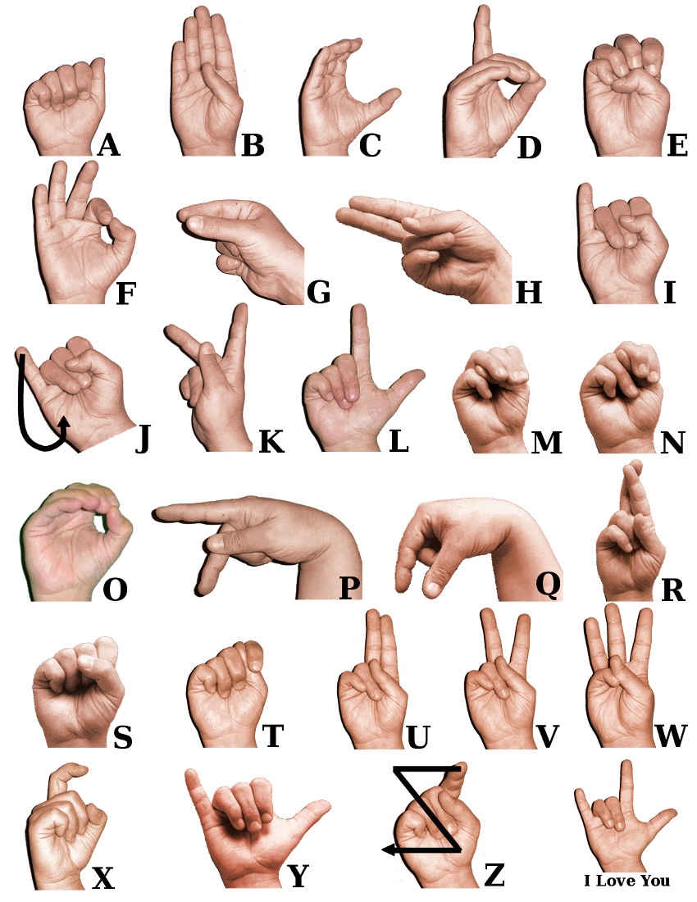
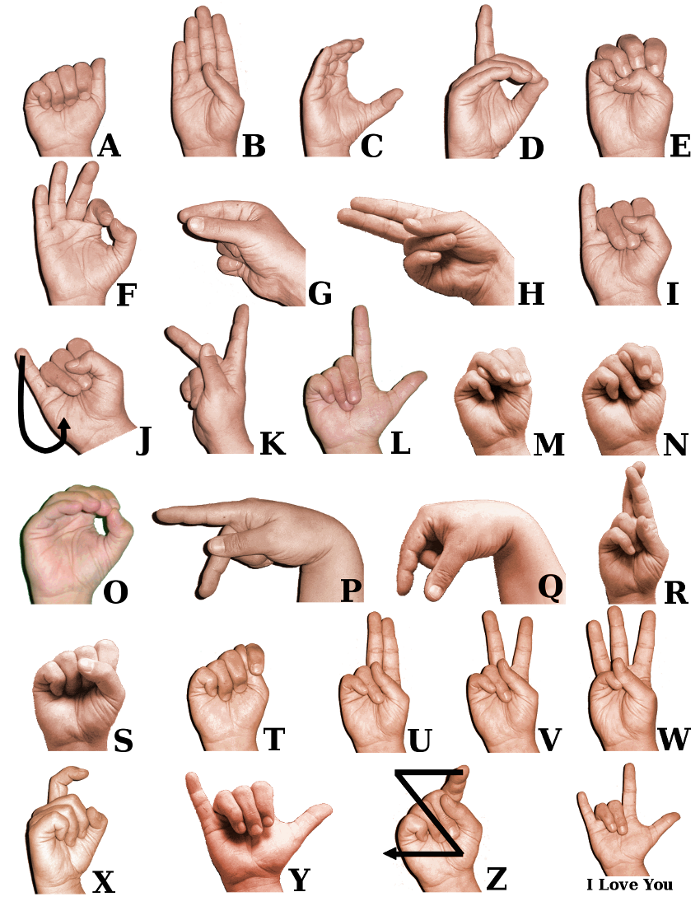
INTRODUCTION
American sign language is a predominant sign language used to communicate with Deaf & Mute people.
Communication is the process of exchange of thoughts and messages in various ways such as speech, signals, behaviour and visuals.
Gestures are the nonverbally exchanged messages and these gestures are understood with vision.
To communicate with others deaf and mute community will have to take help of translators.

Slide 3
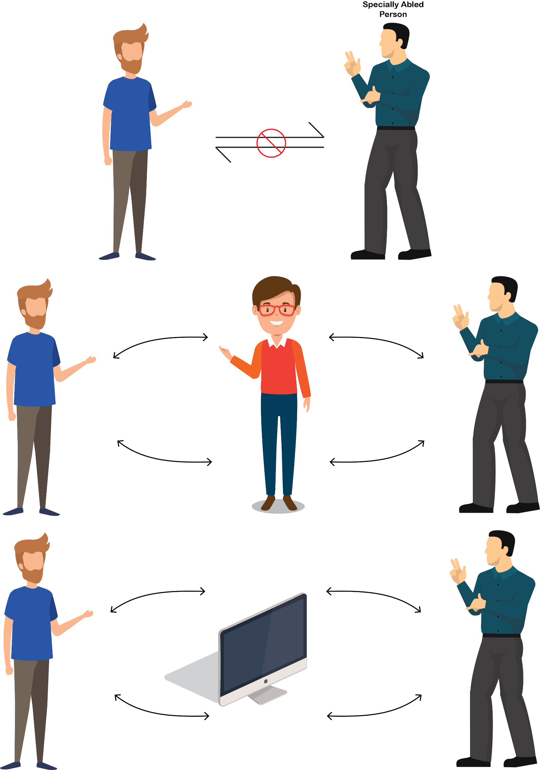
OBJECTIVE
Communication is slow for specially-abled deaf and mute people
Translators are required when it comes to communicating with masses
Hiring a translator is expensive and sometimes translation errors also happen
Privacy can be compromised when bringing a third person in between
A demand for low cost, easily available, and easy to use software is created.

Slide 4
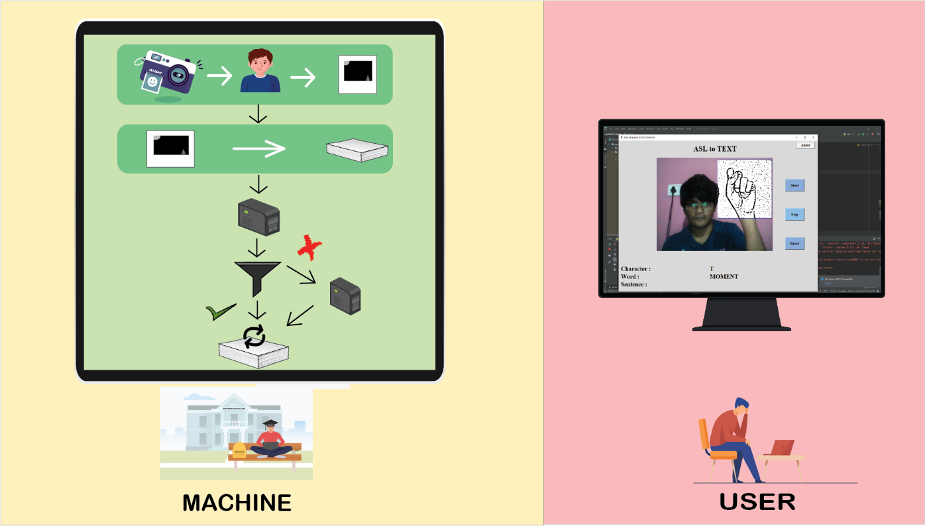
SOLUTION OVERVIEW
Data Acquisition
Data Pre-processing
Passing the data to layer 1 CNN model.
Applying a filter to layer 1 output
Passing the data to respective layer 2 model (if filter triggered).
Printing the Output

Slide 5
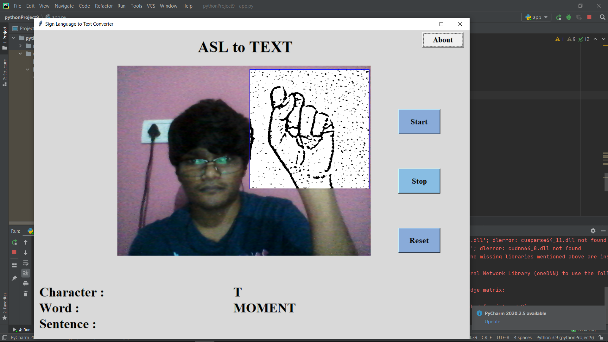
USER INTERFACE
Tkinter + Python = UI
Use of labels
Output Area
Buttons:
Start
Stop
Reset
About

Slide 6
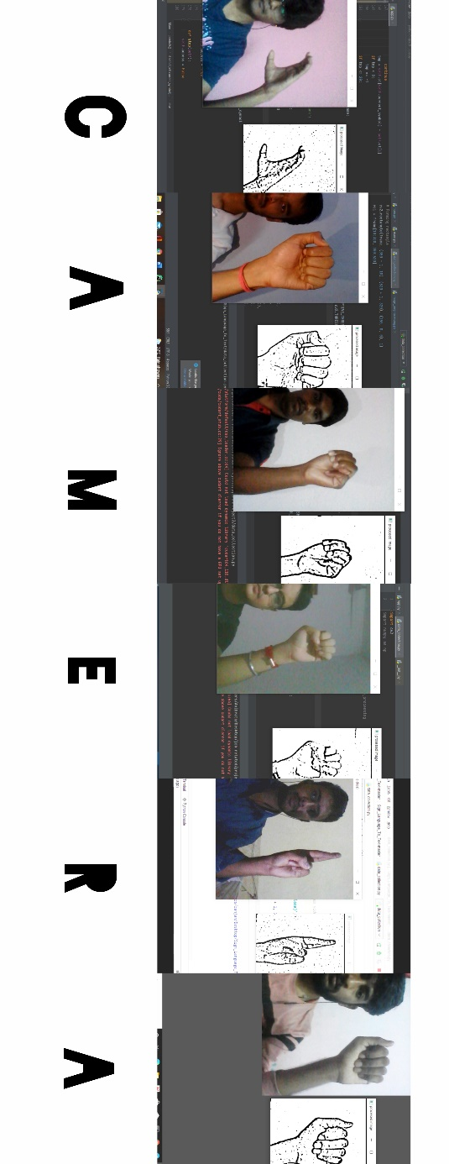
DATA ACQUISITION
Captured around 1,100 images of each of the symbol in ASL (American Sign Language) for training purposes and around 200 images per symbol for testing purpose.
We capture each frame shown by the webcam of our machine and define a Region of Interest (ROI) which is denoted by a bounded square as shown in the image below.
Extracted the ROI which is RGB and convert it into grayscale image.
Apply gaussian blur filter to collected image.
Used Adaptive Threshold technique to separate desirable foreground image objects from the background.

Slide 7
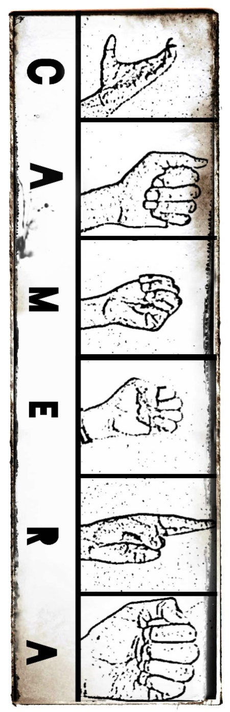
DATA PRE-PROCESSING
Fetching the collected Data
Analysis of size and dimension
Resizing by using openCv into 128 x 128
Converting to 4D NumPy array
Eg. Array [Number of images, length, breadth, channel]

Slide 8
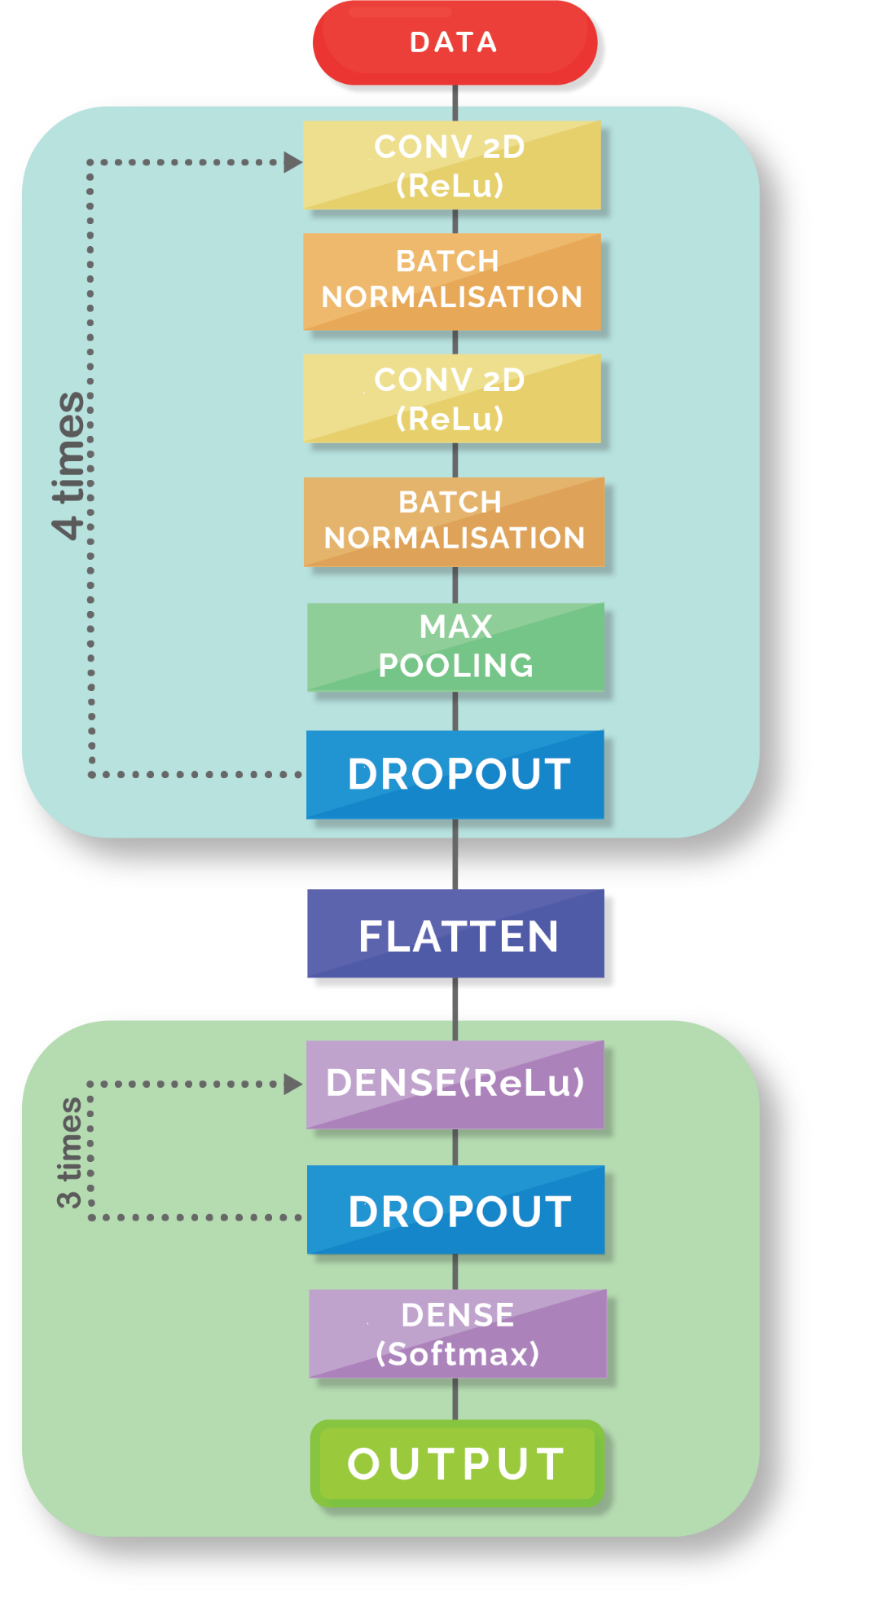
CNN MODEL OVERVIEW
4 pair Conv2D layer
Filter size 64, kernel size 3 x 3, ReLu Activation function used.
Filter size 128, kernel size 3 x 3, ReLu Activation function used.
Filter size 256, kernel size 3 x 3, ReLu Activation function used.
Filter size 512, kernel size 3 x 3, ReLu Activation function used
3 Dense Layer
Unit size 256, ReLu Activation function used
Unit size 128, ReLu Activation function used
Unit size 64, ReLu Activation function used
Output layer
Unit size 27, Softmax activation function

Slide 9
TRAINING AND TESTING
Phase 1 Training:
Used a CNN model to implement a Classifier and fed the collected dataset (pre-processed image files) into the model.
The prediction layer estimates how likely the image will fall under one of the classes. This is achieved using softmax function.
Phase 1 Testing:
We found that certain signs were not being detected accurately.
We recognized that there are certain sets of signs which look similar to the camera and thus produce an uncertain prediction.
{D, R, U}
{S, M, T, N}
Phase 2 Training:
We trained new classifiers again with these signs only
Modified final CNN model:
If during detection we encounter signs belonging to any character other than {D, R, U} and {S, M, T, N}, then we continue to use the phase 1 classifier.
If we detect any signs among {D, R, U} and {S, M, T, N}, then they go through their separate set classifier once again and then their final output is shown to the user.
Phase 2 Testing:
After applying this 2 phase model, we are able to predict almost all characters.

Slide 10
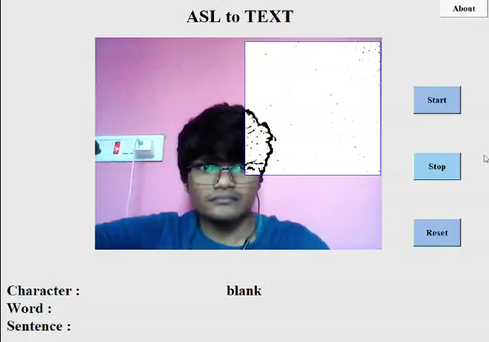
OUTPUT
For the final output, we had some parameters set as:
We store the count of output symbol in a dictionary and print it at “Character”.
If the printed character is detected 25 times and have a Count difference of 10 from the second most detected character, we add it to “Word”.
Whenever the count of “blank” exceeds a certain value, the current “word” is added to “Sentence”.

Slide 11
RESULT
We have achieved an accuracy of 92.37% in our model using the combination of layer 1 and layer 2.
Our main aim was to create a project which can be used with readily available resources for a naïve user wanting to access this technology without spending a lot on hardware.
A sensor not only isn’t readily available but also is expensive. Thus, our model uses a normal webcam of the laptop.

Slide 12
CONCLUSION
A finger spelling sign language translator is obtained which has an overall accuracy of 92.37%.
The main objective has been achieved, that is, the need for an interpreter has been eliminated.
Bad lighting conditions can lead to errors in detection of signs by the algorithm due to surrounding noise. Also, a lighter background contrasting with the hand being detected would yield better outputs as experienced by us.
The other issue that people might face is regarding their proficiency in knowing the ASL gestures. Bad gesture postures will not yield correct predictions.
Future prospects: This project can be used as a web or mobile application in various fields like education, entertainment, and defence. One can use it to predict already existing sign languages like ASL (already done here) and also create their own secret code language (can be used by the army).

Slide 13
